Slide 1
Analyzing the Profiles of Celebrities in NFT: A Graph Analysis
Wang Qian
Supervised by Prof. He Bingsheng
Evaluated by Prof. Henry Chia
Notes:
maximum 25 slides; and leave two minutes for demo
Hi Henry. I am Wang Qian. I am very glad to present my FYP project: Analyzing the profiles of celebrities in NFT: A Graph Analysis to you.

Slide 2
Introduction
01
Celebrities’ impact on cryptocurrency market has been significant
Dogecoin price jumped 50% in one day after Elon Musk’s promoting tweet
Machine learning is used to analyze tweets’ sentiment and its relation with cryptocurrency
Graph analysis is used to study properties of the social network
Notes:
Our project is motivated by that celebrities’ impact on cryptocurrency market has been significant in these two years. They utilize social media, such as Twitter, Reddit, YouTube to express their opinions and the opinions spread quickly on the Internet.
For example, Dogecoin’s price jumped 50% in one day after Elon Musk’s tweet: “Dogecoin is the people’s crypto”
Machine learning model is widely used in tweet sentiment analysis. There exists some work on analyzing the relation between tweet sentiments and cryptocurrency market.
And graph analysis has advantages in studying topological and geographical properties of social network.

Slide 3
Introduction
01
Celebrities impacts on the blockchain is a valuable topic
Number of wallet addresses increase these years: 68.42 million in 2021 [1]
Celebrities dive into NFT areas
A gap between on-chain and off-chain data due to anonymity
Notes:
Then we notice that celebrities’ impacts on the blockchain is a valuable topic.
This is because the number of wallet addresses increase these years. There were 68.42 million wallet addresses up to 2021, showing more people participate in blockchain activities.
Also, celebrities dive into NFT areas. They release their own NFT tokens. For example, Justin Bieber. And they attach influence to them, to promote NFT’s impacts
However, there is a gap between on-chain and off-chain data due to off-chain’s anonymity. Celebrities have Twitter accounts. Also, they have blockchain wallet addresses. However, we may not know their wallet addresses.

Slide 4
Introduction
01
A dataset matching NFT celebrities’ Twitter and wallet addresses
Most datasets are restricted on Twitter
TweetBoost links Twitter and NFT assets, but only 60,000 NFT data [2]
A most complete dataset matching NFT celebrities’ Twitter and their wallet addresses on the blockchain: de-anonymization
Support applications such as fraud detection, NFT celebrities’ recommendations
Notes:
Most research only consider off-chain activities while neglecting on-chain trading actions. So there are possibilities that celebrities conceal their real actions on the blockchain.
Therefore, we aim to build a dataset matching NFT celebrities’ Twitter accounts and wallet addresses.
We read some papers and know that most current datasets are restricted on Twitter: off-chain dataset.
Though there are datasets matching Twitter and OpenSea. TweetBoost links Twitter and NFT assets on OpenSea. However, the number of NFT assets is 60000, it is small.
So, we hope to build a most complete dataset matching NFT celebrities’ Twitter and their wallet addresses on the blockchain. It is de-anonymization of off-chain data.
This dataset can be applied in applications such as fraud detection, NFT celebrities’ recommendations in the future.

Slide 5
Literature Review
02
Social factor influences
Studies prove relationship between social media and the cryptocurrency
1% increase in Tweets leads to 7% of liquidity improvement in next 5 to 10 min [3]
Twitter sentiment predict the returns of Bitcoin [4]
Celebrities’ impacts
Granger-causal relationship proves that Trump’s tweet sentiment’s impacts on Bitcoin’s variables, such as returns, volatility, trading volumes during the pandemic [5]
Significant positive abnormal returns followed Elon Musk’s 47 Twitter events [6]
Notes:
After deciding the aim of this project, I reviewed some literature related to social factor’s influences on cryptocurrency market, Tweet Sentiment Analysis, and graph analysis.
For social factor influences, various studies examine the relationship between it and the cryptocurrency market. For example, a 1% increase in tweets leads to about 7% of liquidity improvement in the next 5 to 10 min.
Also, Twitter sentiment has predictive power for the returns of Bitcoin.
Celebrities’ impacts are significant. For example, Granger-causal relationship proves that Donald Trump’s tweets sentiment can be a predictive tool for Bitcoin’s variables, such as returns, volatility, and trading volumes during the pandemic [8].
Another example is Elon Musk’s 47 cryptocurrency-related Twitter events were followed by significant positive abnormal returns and trading volume in the market [9]

Slide 6
Literature Review
02
Twitter sentiment analysis
NLP systematic workflow
Collecting text
Tokenizing and pre-processing text
Feature engineering
Training
Graph-based model including Twitter follower graph improving polarity classification [7]
Regression model
SVM and regression models are used to predict Bitcoin prices [4].
Price is positively affected by positive Twitter sentiments in the short run [8].
Notes:
As celebrities share their comments on cryptocurrency on social media, the contents of their sayings are a vital source to analyze. Among all social media, twitter has been well-researched.
Twitter sentiment analysis has systematic research methods. The typical workflow includes collecting text, tokenizing text, preprocessing the sentences by removing stopwords, lemmatization and stemming, feature engineering, training and validating models, and predicting and analyzing results.
Besides machine learning, a Graph-Based model including Twitter followers graph improves polarity classification.
Most research in this area utilizes the regression model to prove causal relationships [4]. For example, SVM and regression models are used to predict Bitcoin prices. The result is that Bitcoin price is positively affected by the positive Twitter sentiments in the short run.

Slide 7
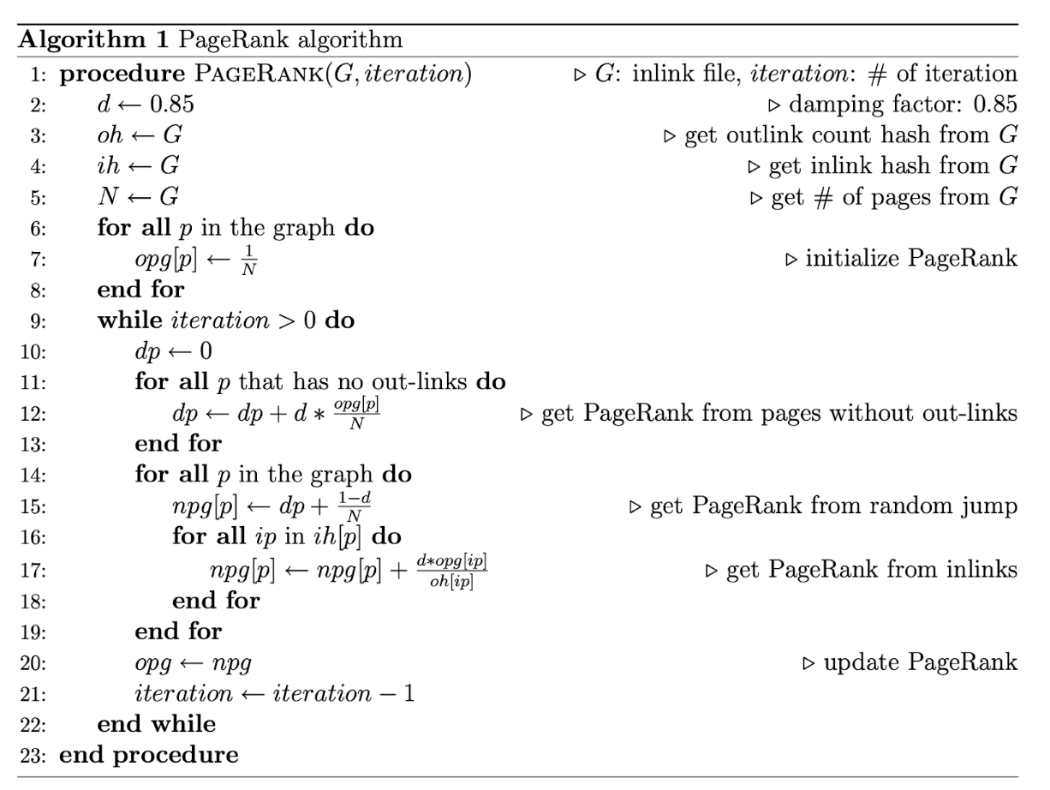
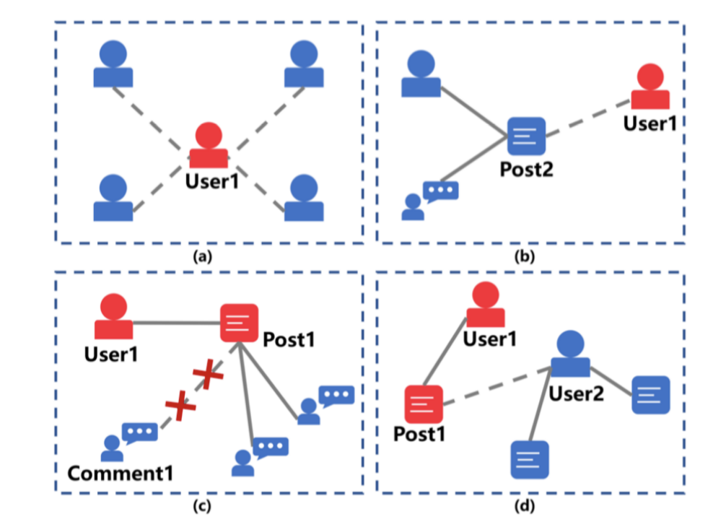
Literature Review
02
Graph analysis
Graph of social media
PageRank
Notes:
In this subpart, I review graph analysis literature including graphs of social media, PageRank, and Graph Neural Network (GNN) literatures.
Social media’s relation between users can be depicted in a graph shown here. Users have following relationship and they can post and repost a tweet. Also, users can comment a tweet.
Then I review PageRank algorithm. The basic idea of page ranking is that a web page is essential if other important pages point to it. This idea can be used in ranking celebrities. After generating the Twitter/Facebook follower graph, where each node represents a user account, each edge from A to B represents A follows B. If one user is followed by many users or celebrities, such as Justin Bieber and Elon Musk, we consider him a celebrity.

Slide 8
Literature Review
02
Graph analysis
Graph Embedding
Project nodes to low-dimensional vector space to represent relationships [9]
Homogeneous graph: deep learning with random walk, Node2Vec, metapath2vec [10]
Heterogeneous graph: proximity-preserving, message-passing, and relation-learning methods [11]
Graph Neural Network
Node’s neighbors’ influences are not the same
Iteratively aggregate features from node’s neighbors
Node level for node classification tasks; edge level for link prediction tasks
Notes:
Then I review graph analysis literature. A common method is analyze graphs is graph embedding. We can project nodes to low-dimensional vector space to represent relationships.
For homogeneous graphs, a common way is to apply random walk algorithm on the graph. Also, there are other baselines such as Node2Vec and metapath2vec
For heterogeneous graphs, there are three common ways: proximity-preserving, message-passing, and relation-learning. Proximity treats nodes with edges as similar nodes. Message-passing will aggregate a node’s neighbor nodes’ information to the node. The goal of relation-learning methods is to learn a scoring function to represents each pair of nodes’ relationship in the graph.
Then I review graph neural network literature. GNN is a prevalent algorithm to detect relationships within nodes in the graph. the main idea of GNN is to iteratively aggregate features from neighbors and integrate these features with the current central node in the propagation.
GNN performs well in downstream tasks such as node classification and link prediction.

Slide 9
Literature Review
02
Blockchain analysis
Blockchain Characteristics
Anonymity: A user interacts with the blockchain with one or several addresses to hide himself [12]
Persistency: Each transaction is verified by distributed network. Records can’t be tampered with [12]
Decentralization: A transaction is done by two peers [12]
Auditability: Users can trace the records iteratively until genesis block [12]
Ethereum
A public blockchain with smart contracts
NFT is under ERC721 standard, distinguished by their ID
ENS: celebrities obtain is to show their identities on Twitter
Notes:
The next part we review is blockchain.
Blockchain can be treated as a public ledger that documents all committed transactions. It has several characteristics: anonymity, persistency, decentralization, and auditability. A user can interact with the blockchain with one address but without verifying himself. Also, as blockchain is a public ledger, each transaction is verifies by distributed network. Decentralization is that a transaction is done by two peers without approval by central banks. Another characteristic is auditability. As each transaction is validated and documented with a timestamp, users can trace the records iteratively until the genesis block. So, the data in the blockchain is transparent.
There are many kinds of blockchain. We choose Ethereum as our starting point. Ethereum is a public blockchain attracting much attention these years
Ethereum has some advantages. Ethereum supports many applications such as NFT with smart contracts.
Non-fungible tokens (NFTs) are unique tokens generated under the ERC721 standard. NFT is under ERC721 standard. Each token is distinguished by their ID.
Another useful application is ENS. ENS is the short form of Ethereum Name Service. It maps a human-readable name alice.eth to an Ethereum address. Many celebrities use ENS as their screen names on Twitter.

Slide 10
Literature Review
02
Summary
Graph analysis
Collecting on-chain and off-chain data
Ethereum as on-chain data source; Twitter as off-chain data source
Build a graph then do analysis on it
Limitations
Most current research does not consider on-chain data
Dataset is not complete
Notes:
In summary, we review social factor’s influences, graph analysis, and blockchain analysis. From them, we know that we need to collect on-chain and off-chain data. Also, we choose Ethereum as the on-chain data source. Twitter as the off-chain data source.
After collecting data, we build a graph then do analysis on it.
Current literature’s limitations are of two points: most current research does not consider on-chain data. And current dataset’s amount of data is not enough. Limitations are where we can improve on.

Slide 11
Challenges
03
Anonymous mechanisms
Everyone can register a wallet address without verifying identity
On-chain users can hide their off-chain identities easily
Complete dataset matching celebrities’ Twitter and blockchain profiles
How to define celebrities?
Big scale of data
Celebrities’ relationships
Crawling on-chain and off-chain data
Twitter API’s restrictions
Anti-crawling mechanisms
Notes:
Then we analyze the challenges of this project.
First challenge is the anonymous mechanisms. Everyone can register a wallet address without identity verification. So, it is to get the celebrities’ on-chain wallet addresses. Also, on-chain users can hide their off-chain identities easily by registering many addresses.
Another challenge is the complete dataset. We hope to build a complete data set matching celebrities’ Twitter accounts and blockchain activities. But how to define celebrities and how to get a list of celebrities. Also, there is a large scale of data. The collection process is hard and processing time may be long. In addition, celebrities have relationships, how to capture them?
The third challenge is about the implementation details. We need to crawl on-chain and off-chain data. For example, Twitter has its official API. But Twitter’s API has restrictions on the number of requests everyday. Other websites have some anti-crawling mechanisms such as google captcha.

Slide 12
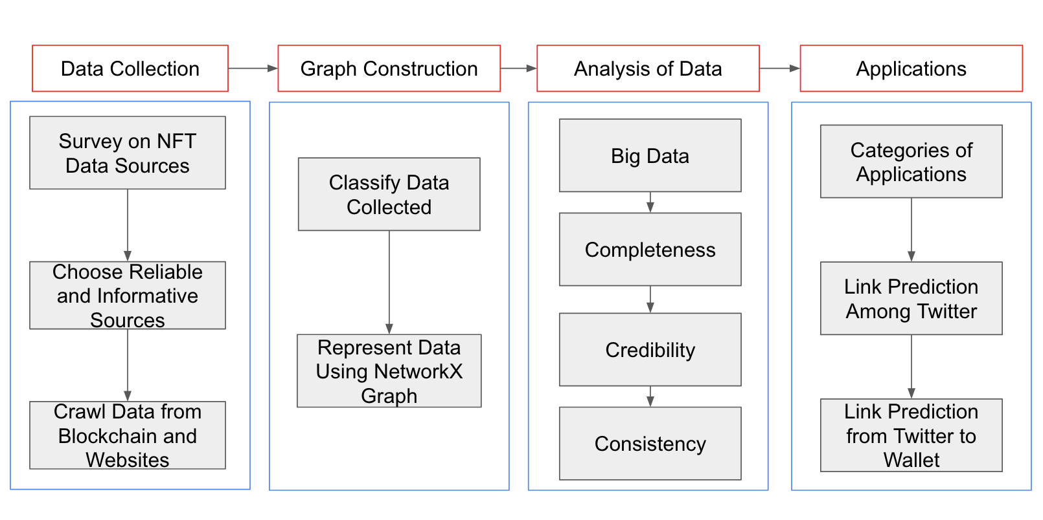
Overview
04
Notes:
Here, it is the overview of this project. We divide the whole project to four parts. First part is to collect data. We mainly focus on the collection. We did a complete survey then choose reliable and informative sources. Then we crawl data from those websites.
After collect them, we construct the data to a networkx graph.
Then we analyze the data quality we have gained. Mainly we test the big data,completeness, credibility, and consistency.
The last step we do is to deploy applications on the graph we have built. We do link prediction among Twitter accounts and link prediction from Twitter accounts to wallet addresses to show the data we collect is useful.

Slide 13
Methodology
05
Data collection
Active wallet addresses: top 500 NFT communities based on market cap
NFTScan API
Keep ERC721 contracts
On-chain transactions:
All transaction records from 2022-3 to 2022-8
Extract transactions among active wallet addresses
Notes:
In this part, I will introduce the methodology and implementation details I have used in this project.
For on-chain data, we start from collecting active addresses: top 500 NFT communities based on market cap. We use NFTscan APi and keep ERC721 contracts.
Then we also collect on-chain transaction records from 2022-3 to 2022-8 from Ethereum. Then we extract all transactions among active wallet addresses we have collected.

Slide 14
Methodology
05
Data collection
Famous NFT platforms
A complete survey on 13 platforms
OpenSea: 12955 profile pages among all active wallet addresses
Anti-crawling mechanism: rotate IPs in IP pool
Twitter
Twitter official APi is restricted: turn to Selenium crawling
Following/Follower relationships: 542,708 accounts, 944,129 following relationships
ENS domain screen name: 87701 accounts with ENS screen names
Hexagon-shaped avatar verification: 5610 accounts verify their avatar’s address
Notes:
We do a complete survey
Then from Twitter we crawl

Slide 15
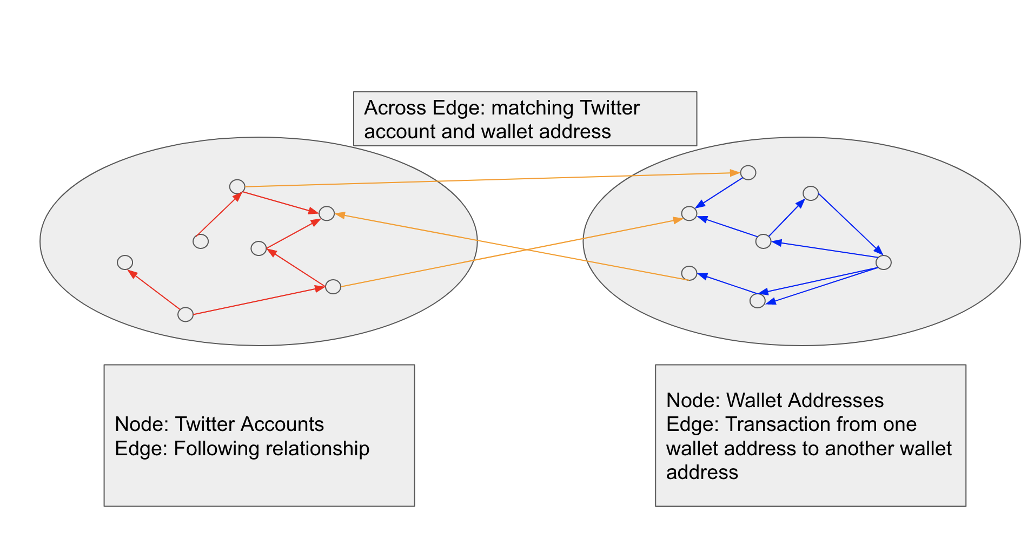
Methodology
05
Graph construction
Notes:
After collecting, we build a heterogeneous graph.
// arial font

Slide 16
Results
06
Source | Amount of data
Twitter | 542,708 Twitter accounts and their profiles and 944,129 following relationships among these accounts
ethleaderboard | 87701 Twitter accounts with ENS names
Twitter Hexagon Verification | 5610 Twitter accounts with attached wallet addresses
OpenSea | 12955 wallet addresses with attached Twitter accounts
NFTScan | 371 ERC721 NFT contracts
Ethereum Blockchain | 343,878 wallet addresses and 2,368,134 transaction records among these addresses
Notes:
Then we do analysis of the data we have collected

Slide 17
Results
06
Data quality dimension | Evaluation
Accuracy [13] | Except ENS domain screen name, all other data sources are reliable
Completeness [13] | More than 8% of all active wallet addresses
Consistency [13] | Twitter handlers are stable. Ethereum addresses are impossible to tamper with.
Uniqueness [13] | Clean duplicated data first and unique identifiers
Timeliness [13] | Data was collected in July and Aug. Transactions were from Mar to Aug
Validity [13] | Twitter handlers and original Ethereum addresses
Notes:
Also, we evaluate the data quality from many dimensions

Slide 18
Applications
07
Possible applications
Node classification
On-chain: Holding NFT values to classify whale accounts
Off-chain: Celebrities belong to artists, NFT developers, super stars on Twitter
Clustering
Detect wash trading if several wallet addresses transact among them frequently
Group nodes on Twitter based on their following relationships
Link Prediction
Among Twitter accounts
From Twitter accounts to Ethereum wallet addresses
Notes:
Then we consider applications we can build on the graph we have built.
For node classification, we can do on-chain node classifications if their holding NFT values to classify whale accounts.
Also, for off-chain data, we can classify celebrities belong to artists, NFT developers, super stars maybe according to their number of fans
For clustering, we can detect dense subgraphs if several wallet addresses transact among them frequently. Also, for off-chain Twitter accounts, we can detect a group showing the users in the group know them in reality.
Link prediction

Slide 19
Applications
07
Link prediction among Twitter accounts
Node embedding
DeepWalk [14]: Random walk idea
SBERT [15]: Convert each profile to a 386-dimension vector
AUC to evaluate as it is a binary-classification task
Randomly choose the same amount of positive and negative samples
Delete these edges from the graph
Results
Concatenating source and target nodes; concatenating DeepWalk and SBERT embeddings
AUC reaches 0.81

Slide 20
Applications
07
Link prediction from Twitter accounts to wallet addresses
Three base models: GCN [16], ComplEx [17], HGT [18]
GCN: Proximity-learning method for homogeneous graphs
ComplEx: Relational-learning method for both homogeneous and heterogeneous graphs
HGT: Message-passing method for both homogeneous and heterogeneous graphs
Notes:
Then I will introduce the progress I have made so far.
At first, we do preliminary investigation. There exist many open-sourced cryptocurrencies datasets. Yahoo Finance provides many coins, such as Bitcoin’s daily open price, close price, and market volume [33]. BitStamp provides free hourly and minutely cryptocurrency data, but the range is restricted to a few cryptocurrencies [34]. To get more detailed information on Bitcoin’s price at a specific minute, CoinMarketCap provides an official API.
There exist many open-sourced cryptocurrencies datasets. Yahoo Finance provides many coins, such as Bitcoin’s daily open price, close price, and market volume [33]. BitStamp provides free hourly and minutely cryptocurrency data, but the range is restricted to a few cryptocurrencies [34]. To get more detailed information on Bitcoin’s price at a specific minute, CoinMarketCap provides an official API.
For crawling Twitter data, there are three methods: using open-sources modules, Twitter's official API, and web scraping tricks. Open-source modules can’t fetch a complete following list of a user. Twitter official API has a strict restriction on number of requests. Web scraping using Selenium with Chromedriver can solve previous two problems. So we choose web scraping as our crawling method.
However, some information on social media is misleading. “Talk is cheap.” Celebrities may spread fake opinions on social media. It is possible to trace Bitcoin addresses using legal analysis [38]. After getting enough addresses, we can do a mapping between celebrities' cryptocurrency addresses and their social accounts to analyze the relations between actions in social media and actions in the cryptocurrency market.

Slide 21
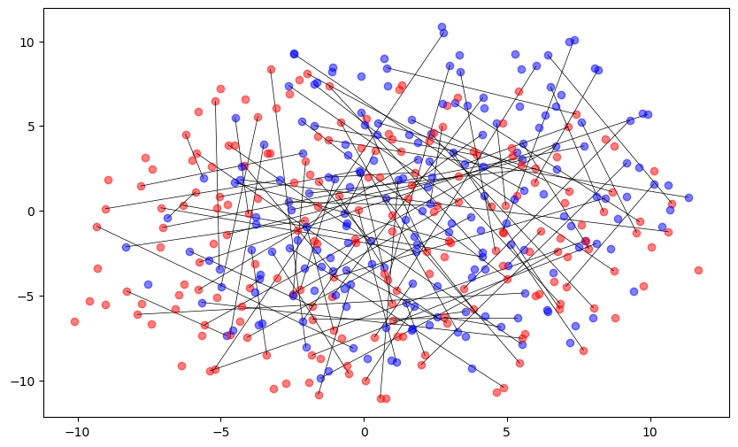
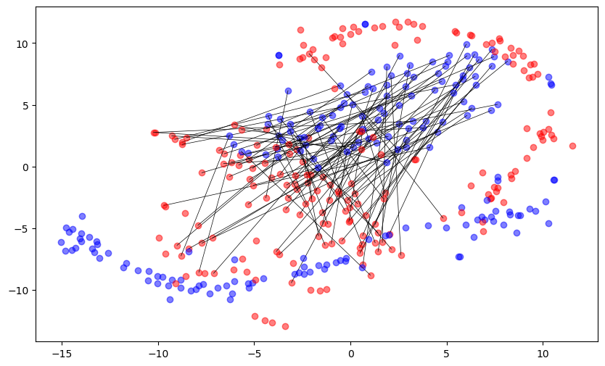
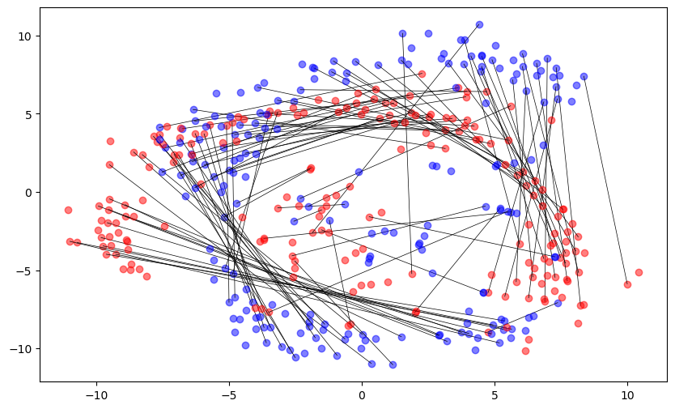
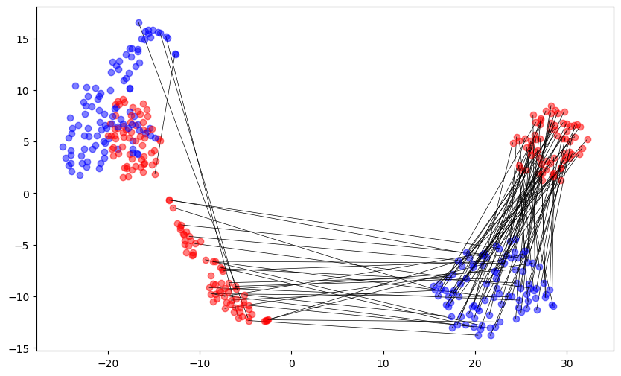
Applications
07
Link prediction from Twitter accounts to wallet addresses
Node embeddings visualizations
GCN Homo Graph
ComplEx Hetero Graph
ComplEx Homo Graph
HGT Hetero Graph
Notes:
Here is the visulization of node embeddings in different training models

Slide 22
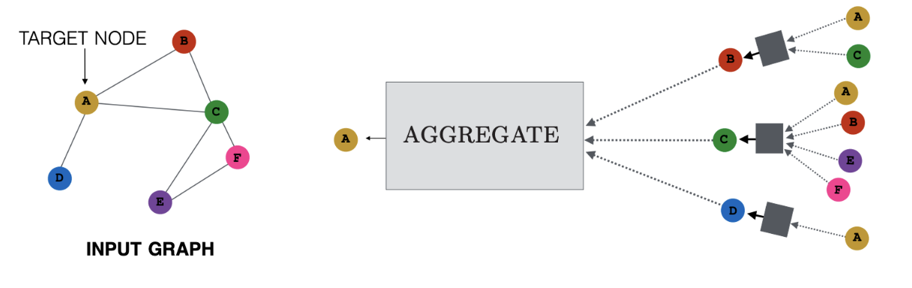
Applications
07
Link prediction from Twitter accounts to wallet addresses
Findings
Heterogeneous graph performs better than homogeneous graph: hetero keeps more info
GNN performs better than GCN: GNN utilizes RNN
HGT performs the best: a message-passing model
GNN Layers in HGT

Slide 23
Conclusions
08
Contributions
A complete dataset matching NFT celebrities’ Twitter accounts and Ethereum wallet addresses
This dataset is of high quality and big amount
Can be treated as a benchmark for on-chain and off-chain matching
Applications’ AUCs show the dataset is useful in future applications
Notes:
Then I will introduce the progress I have made so far.
At first, we do preliminary investigation. There exist many open-sourced cryptocurrencies datasets. Yahoo Finance provides many coins, such as Bitcoin’s daily open price, close price, and market volume [33]. BitStamp provides free hourly and minutely cryptocurrency data, but the range is restricted to a few cryptocurrencies [34]. To get more detailed information on Bitcoin’s price at a specific minute, CoinMarketCap provides an official API.
There exist many open-sourced cryptocurrencies datasets. Yahoo Finance provides many coins, such as Bitcoin’s daily open price, close price, and market volume [33]. BitStamp provides free hourly and minutely cryptocurrency data, but the range is restricted to a few cryptocurrencies [34]. To get more detailed information on Bitcoin’s price at a specific minute, CoinMarketCap provides an official API.
For crawling Twitter data, there are three methods: using open-sources modules, Twitter's official API, and web scraping tricks. Open-source modules can’t fetch a complete following list of a user. Twitter official API has a strict restriction on number of requests. Web scraping using Selenium with Chromedriver can solve previous two problems. So we choose web scraping as our crawling method.
However, some information on social media is misleading. “Talk is cheap.” Celebrities may spread fake opinions on social media. It is possible to trace Bitcoin addresses using legal analysis [38]. After getting enough addresses, we can do a mapping between celebrities' cryptocurrency addresses and their social accounts to analyze the relations between actions in social media and actions in the cryptocurrency market.

Slide 24
Conclusions
08
Lessons Learnt
First step is the hardest, don’t be afraid
Start from reading papers, watching online courses
Focus on “However” part, this is where I can improve
A new field Web3
Very hot area with new techniques
Find materials then get hands dirty
Don’t give up when face problems
Many sources. e.g. searching on StackOverflow; asking a senior Ph.D.
Asking questions is a sign of courage
Notes:
Then I want to talk about lessons I have learnt in the fyp.
First thing I learned is the first step is always the hardest. To begin with, I read many papers. However, most papers did not show the technical details. I also forgot what I read after two or three days. Then, I realized that’s because I was not familiar with web3 and blockchain. So, I watched several courses on YouTube introducing ethereum, NFT, smart contracts and other concepts. I also wrote some toy web3 code to interact with Ethereum.
After that, I went back to read papers. I could understand much more than the first time I read them. Then I focus on “However” part. From that, I learned that current papers did not gather enough data about identities of holders who have blockchain wallet addresses. As celebrities influence cryptocurrency market, I decided my topic is to analyze the on-chain and off-chain profiles of celebrities.
The second thing I learned is about techniques. As web3 is a new and hot field, many new techniques exist. I learnt from online materials such as web3.py’s documentations, NFTScan API’s requests. Also, to crawl websites, I learnt to use selenium and how to bypass anti-crawling mechanisms by using IP Pool. I learnt I should not be afraid of getting my hands dirty. It is normal that learning curve is steep.
The last but not least thing I learnt is do not give up when facing problems. Instead, go to search for help from all possible sources. There are many sources such as StackOverflow. Also I can ask senior Ph.Ds in the lab as they know many details. Maybe how to set parameters, how to draw a clear graph. Asking questions is a sign of courage. It is not a shameful thing.

Slide 25
References
09
1. Anthony, J. (2022, January 14). Number of blockchain wallet users 2022/2023: Breakdowns, timelines, and predictions. Financesonline.com. Retrieved October 28, 2022, from https://financesonline.com/number-of-blockchain-wallet-users/
2. Kapoor, A., Guhathakurta, D., Mathur, M., Yadav, R., Gupta, M., & Kumaraguru, P. (2022, April). Tweetboost: Influence of social media on nft valuation. In Companion Proceedings of the Web Conference 2022 (pp. 621-629).
3. Choi, H. (2021). Investor attention and bitcoin liquidity: Evidence from bitcoin tweets. Finance Research Letters, 39, 101555.
4. Kraaijeveld, O., & De Smedt, J. (2020). The predictive power of public Twitter sentiment for forecasting cryptocurrency prices. Journal of International Financial Markets, Institutions and Money, 65, 101188.
5. Huynh, T. L. D. (2021). Does bitcoin react to Trump’s tweets?. Journal of Behavioral and Experimental Finance, 31, 100546.
6. Ante, L. (2021). How Elon Musk's twitter activity moves cryptocurrency markets. Available at SSRN 3778844.
7. Speriosu, M., Sudan, N., Upadhyay, S., & Baldridge, J. (2011, July). Twitter polarity classification with label propagation over lexical links and the follower graph. In Proceedings of the First workshop on Unsupervised Learning in NLP (pp. 53-63).
8. Georgoula, I., Pournarakis, D., Bilanakos, C., Sotiropoulos, D., & Giaglis, G. M. (2015). Using time-series and sentiment analysis to detect the determinants of bitcoin prices. Available at SSRN 2607167.
9. Jin, D., Huo, C., Liang, C., & Yang, L. (2021, April). Heterogeneous graph neural network via attribute completion. In Proceedings of the Web Conference 2021 (pp. 391-400).
10. Hu, Z., Dong, Y., Wang, K., & Sun, Y. (2020, April). Heterogeneous graph transformer. In Proceedings of The Web Conference 2020 (pp. 2704-2710).
Notes:
This is the reference list.

Slide 26
References
09
11. Yang, C., Xiao, Y., Zhang, Y., Sun, Y., & Han, J. (2020). Heterogeneous network representation learning: A unified framework with survey and benchmark. IEEE Transactions on Knowledge and Data Engineering.
12. Zheng, Z., Xie, S., Dai, H. N., Chen, X., & Wang, H. (2018). Blockchain challenges and opportunities: A survey. International journal of web and grid services, 14(4), 352-375.
13. Smartbridge, “Data done right: 6 dimensions of data quality,” Smartbridge, 18-Oct-2021. [Online]. Available: https://smartbridge.com/data-done-right-6-dimensions-of-data-quality/. [Accessed: 18-Oct-2022].
14. Perozzi, B., Al-Rfou, R., & Skiena, S. (2014, August). Deepwalk: Online learning of social representations. In Proceedings of the 20th ACM SIGKDD international conference on Knowledge discovery and data mining (pp. 701-710).
15. Reimers, N., & Gurevych, I. (2019). Sentence-bert: Sentence embeddings using siamese bert-networks. arXiv preprint arXiv:1908.10084.
16. Hamilton, W., Ying, Z., & Leskovec, J. (2017). Inductive representation learning on large graphs. Advances in neural information processing systems, 30.
17. Trouillon, T., Welbl, J., Riedel, S., Gaussier, É., & Bouchard, G. (2016, June). Complex embeddings for simple link prediction. In International conference on machine learning (pp. 2071-2080). PMLR.
18. Hu, Z., Dong, Y., Wang, K., & Sun, Y. (2020, April). Heterogeneous graph transformer. In Proceedings of The Web Conference 2020 (pp. 2704-2710).
Notes:
This is the reference list.

Slide 27
THANK YOU
Notes:
This is the end. Thank you so much for your time.

